Slide 1
LISTENING
UNIT 5: PART 1 – PHOTO
DESCRIPTION (2)

Slide 2
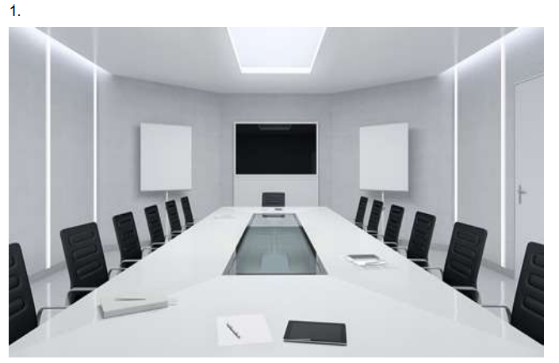
AUDIO TRACK 9
Part 1: Listen and choose the statement that best describes the picture

Slide 3
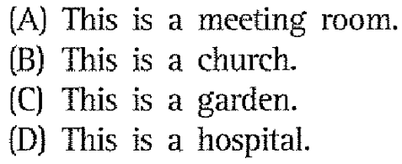
AUDIO TRACK 9
Part 1: Listen and choose the statement that best describes the picture

Slide 4


Slide 5
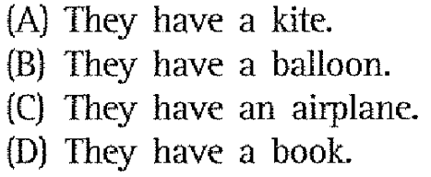

Slide 6
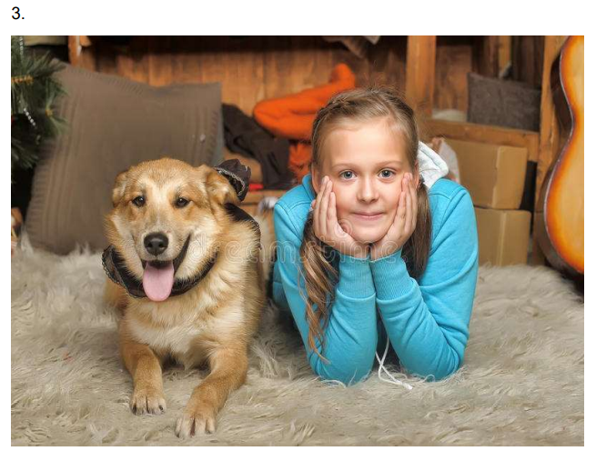

Slide 7
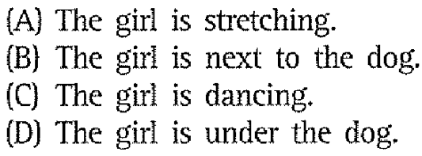

Slide 8
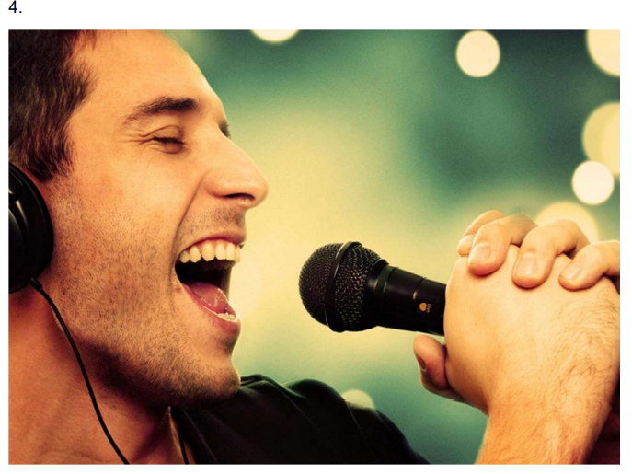

Slide 9
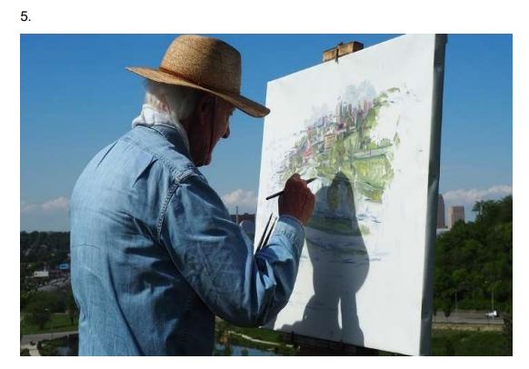

Slide 10
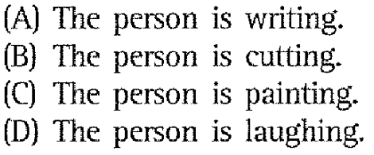

Slide 11

AUDIO TRACK 10 Part 1: Listen and choose the statement that best describes the picture

Slide 12
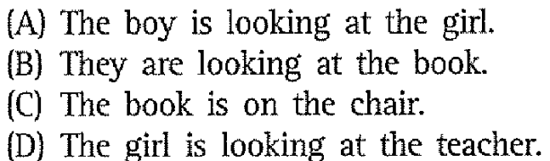
AUDIO TRACK 10 Part 1: Listen and choose the statement that best describes the picture

Slide 13
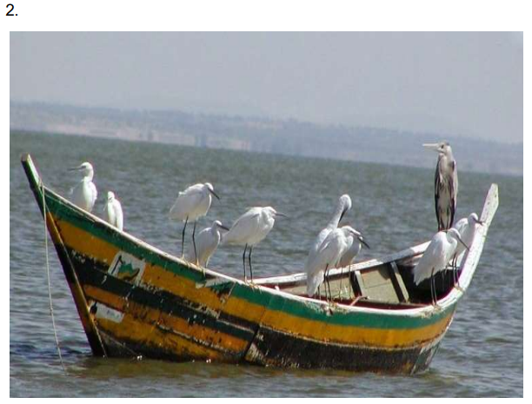

Slide 14
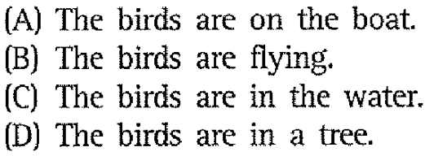

Slide 15
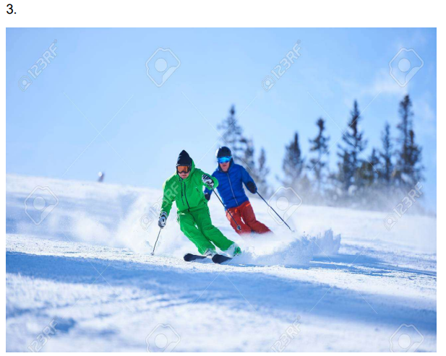

Slide 16
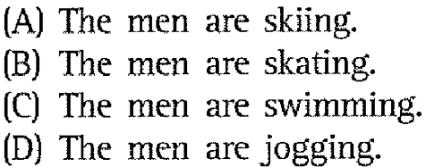

Slide 17


Slide 18
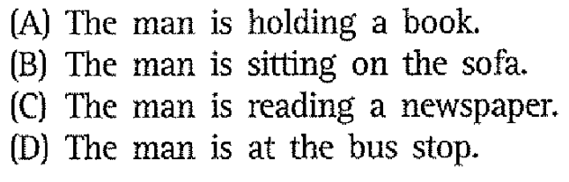

Slide 19
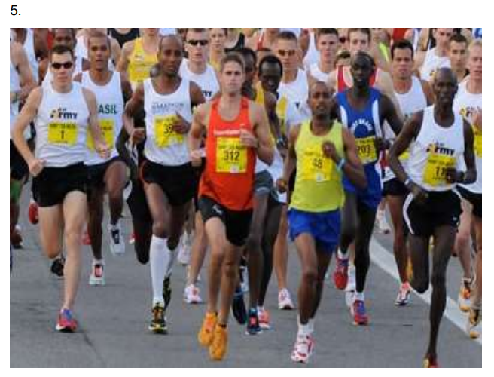

Slide 20
